Slide 1
Data Analyst Professional Findings Report
Project Title: Analysis of Technology and Developer Trends (Stack Overflow 2023)
Prepared by: Abdullah Mohammed Abdulrahman Al-Sharif
Course: IBM Data Analytics Professional Certificate (Coursera)
Date: March 15, 2026

Slide 2
Slide 1: Title Slide
Project Name: Global Developer Survey Insights 2023.
Student Name: Abdullah Mohammed Abdulrahman Al-Sharif.
Date: March 15, 2026.
Affiliation: IBM Data Analytics Specialization.

Slide 3
Slide 2: Outline
Section 1: Executive Summary & Introduction.
Section 2: Methodology & Data Wrangling.
Section 3: Technical Findings (Languages, Databases, Job Roles(
Section 4: Advanced Insights (Compensation, AI Tools, Remote Work(.
Section 5: Looker Studio Dashboards.
Section 6: Overall Findings, Conclusion, and Appendix.

Slide 4
Slide 3: Executive Summary
Dominance: JavaScript and SQL remain the bedrock of the industry for current deployment.
Future Shift: A significant migration is observed toward high-performance languages like Rust and Go.
Database Leadership: PostgreSQL has emerged as the most desired database for 2024 and beyond.
AI Integration: 45% of developers are already using AI tools to augment their coding productivity.
Demographics: The market is driven by young professionals (25 -34 years old )with a strong preference for Hybrid work.

Slide 5
Slide 4: Introduction
Objective: To transform raw survey data into actionable insights for tech stakeholders.
Target Audience: CTOs, Hiring Managers, and Aspiring Developers.
Value Proposition: This report identifies the gap between current skills and future market demands, enabling better career and project planning.

Slide 6
Slide 5: Methodology
Data Source: Stack Overflow Annual Developer Survey 2023 (90,000+) respondent.
Processing Steps:
Data Cleaning: Filtered for the Top 10 results in each category to eliminate noise.
Imputation: Missing values were filled using the Mode to maintain statistical integrity.
Cross-Referencing: Validated findings against the job-postings.xlsx file to ensure the supply of skills matches market demand.

Slide 7
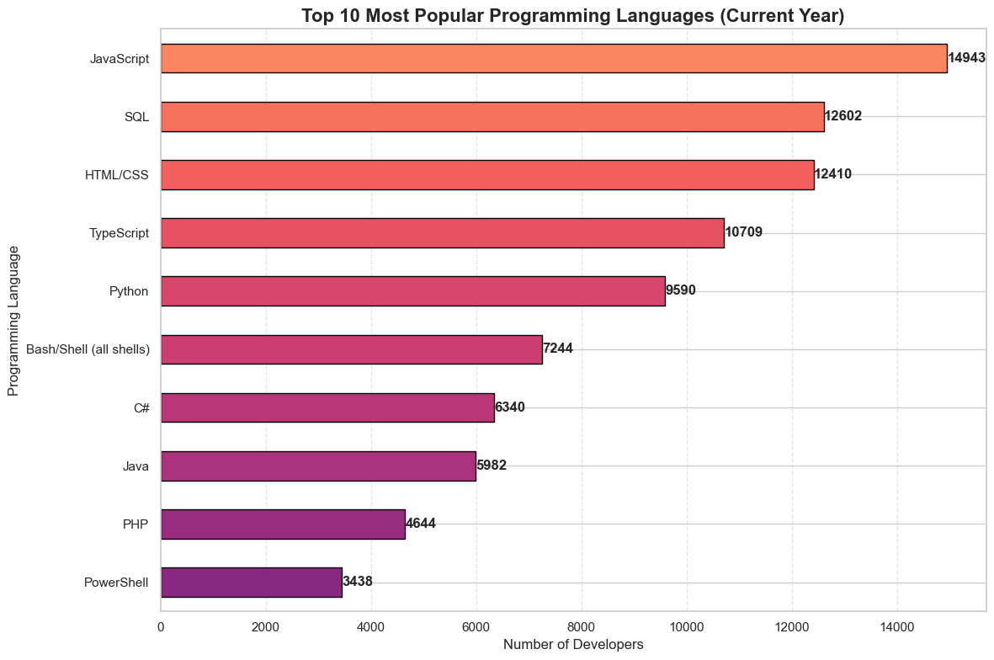
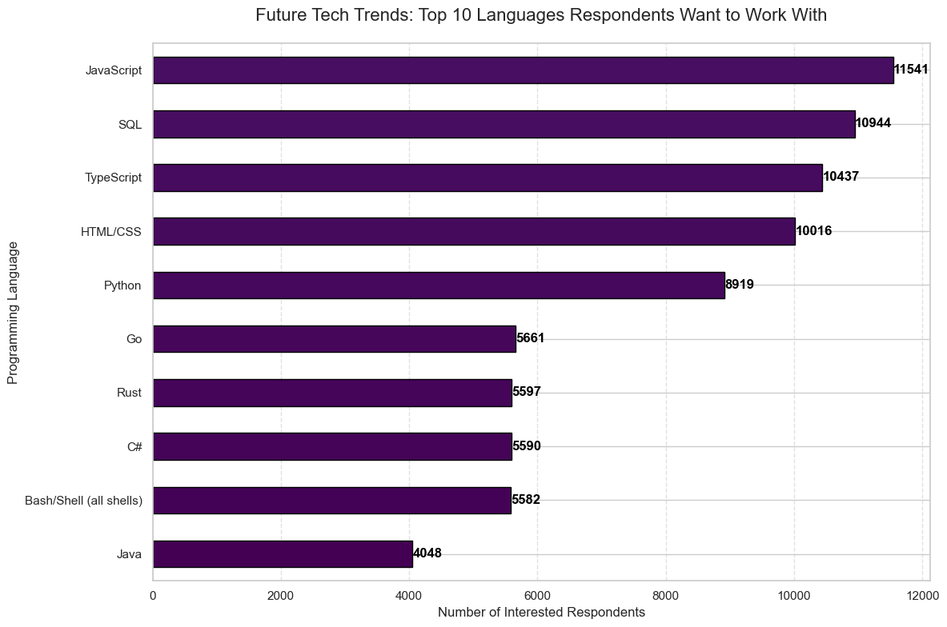
Slide 6 & 7: Results - Programming Language Trends
Top 10 Most Popular Programming Languages
Future Tech Trends Top 10 Languages Respondents Want to Work With.png

Slide 8
Slide 6 & 7: Results - Programming Language Trends
Detailed Analysis:
Current Usage: JavaScript leads with 14,943 users, followed by SQL and HTML/CSS, confirming the continued importance of Web Development.
Future Desire: While JavaScript stays high, Rust and Go show a massive surge in interest. This indicates a shift toward "Safe" and "Performant" system-level programming.
Implication: Developers should consider learning TypeScript and Python to remain competitive in the coming year.

Slide 9
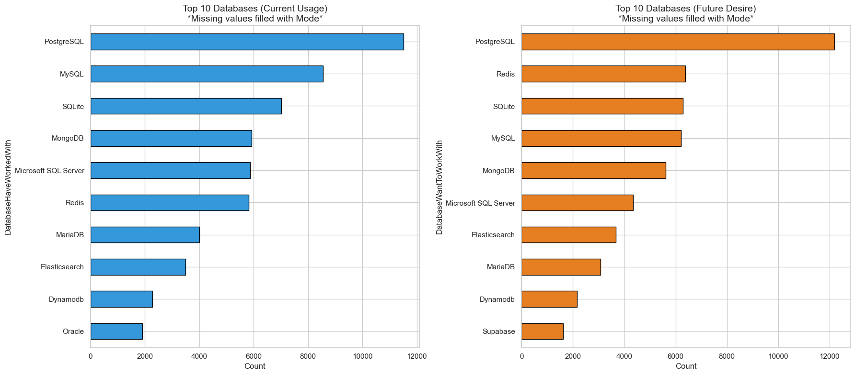
Slide 8 & 9: Results - Database Trends

Slide 10
Slide 8 & 9: Results - Database Trends
Detailed Analysis:
PostgreSQL is the clear winner, being both the most used and the most desired (12,000+) respondents.
Traditional systems like Microsoft SQL Server are seeing a decline compared to open-source flexible solutions like Redis and Supabase.
Implication: The industry is moving toward open-source ecosystems that offer better scalability and lower licensing costs.

Slide 11
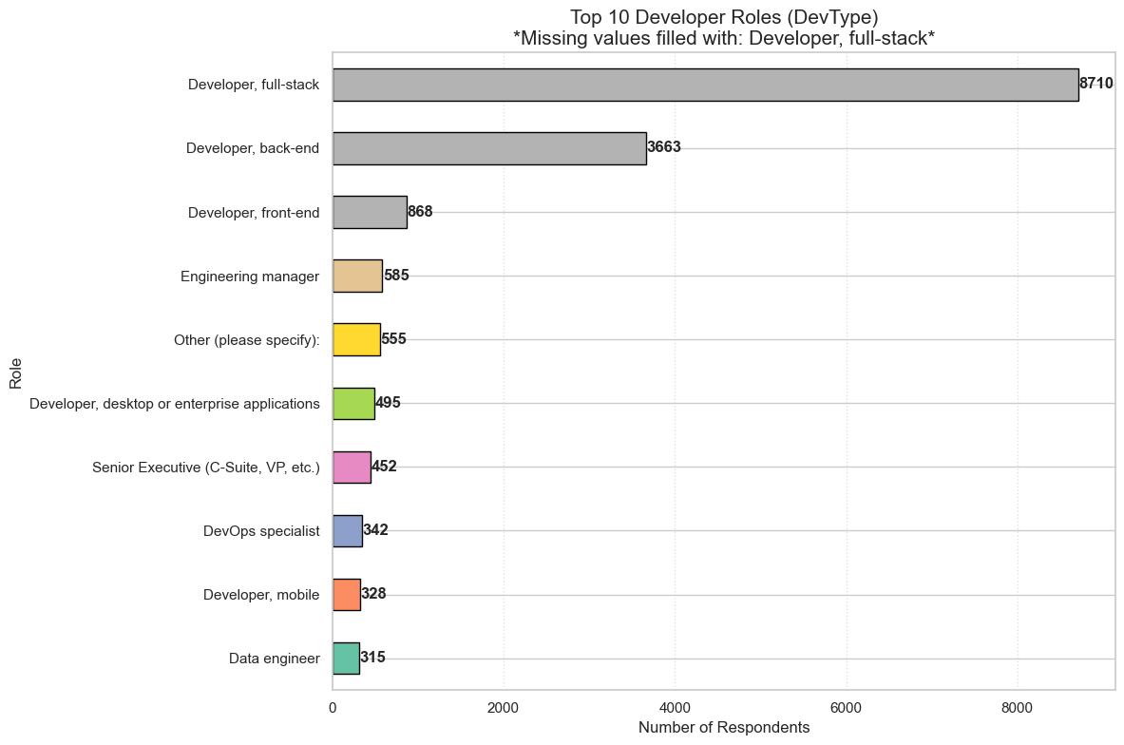
Slide 10: Job Postings Visualization
Analysis: Derived from job-postings.xlsx (Sorted Descending).
Insight: Full-stack Developer roles are the most frequent, which perfectly aligns with the high usage of JavaScript/SQL. Data Engineering follows closely, highlighting the need for professionals who can build robust data pipelines.

Slide 12
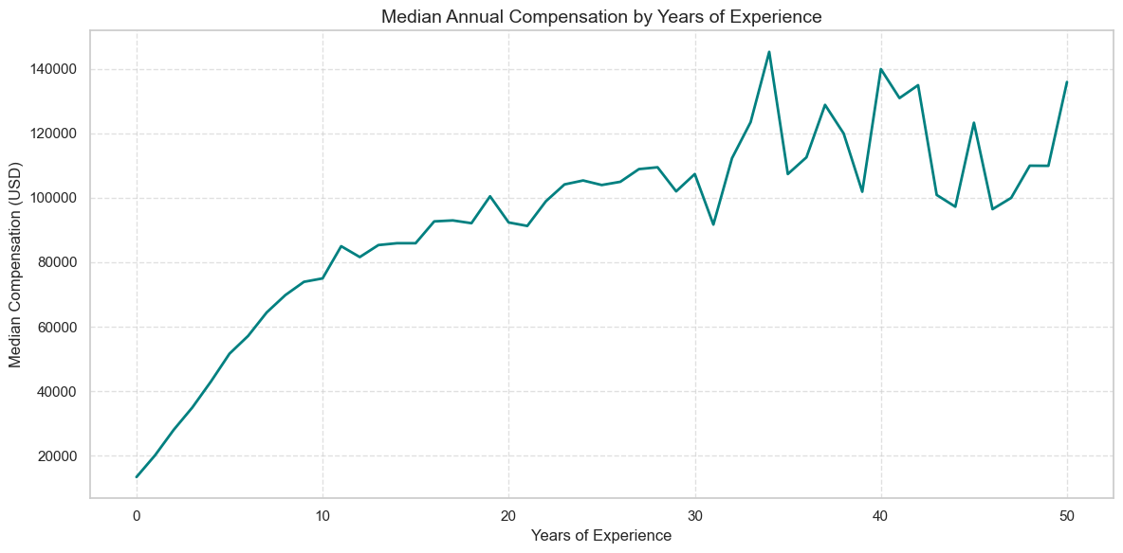
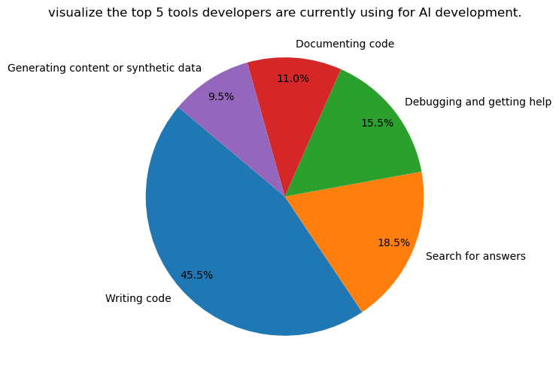
Slide 11: Innovative Insights - Compensation, AI, and Industry
Median Annual Compensation by Years of Experience
visualize the top 5 tools developers are currently using for AI development

Slide 13
Slide 11: Innovative Insights - Compensation, AI, and Industry
Analysis: There is a direct correlation between Experience and Compensation, with a steep increase in salary during the first 10 years.
AI Integration: 45.5% of AI usage is for Writing Code. This is a revolutionary shift; developers who master AI-assisted coding are likely to be more productive and command higher salaries.

Slide 14
Slide 12, 13, 14: Looker Studio Dashboards

Slide 15
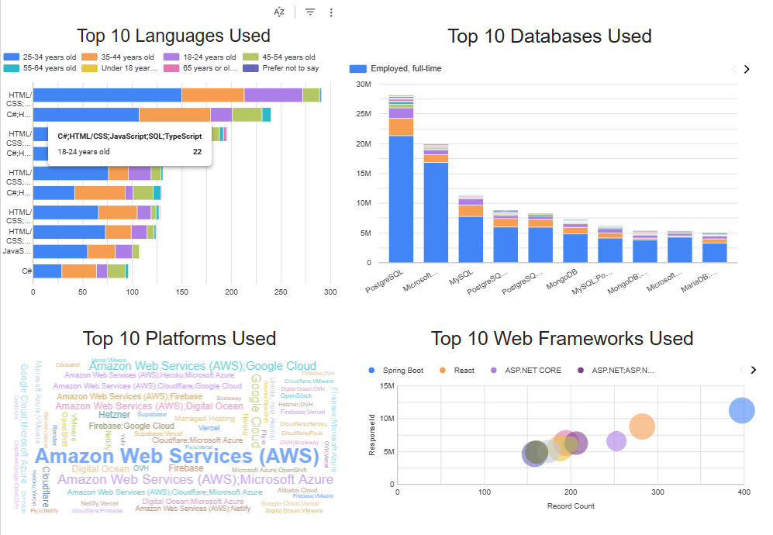
Slide 12
Shows AWS and React dominance

Slide 16
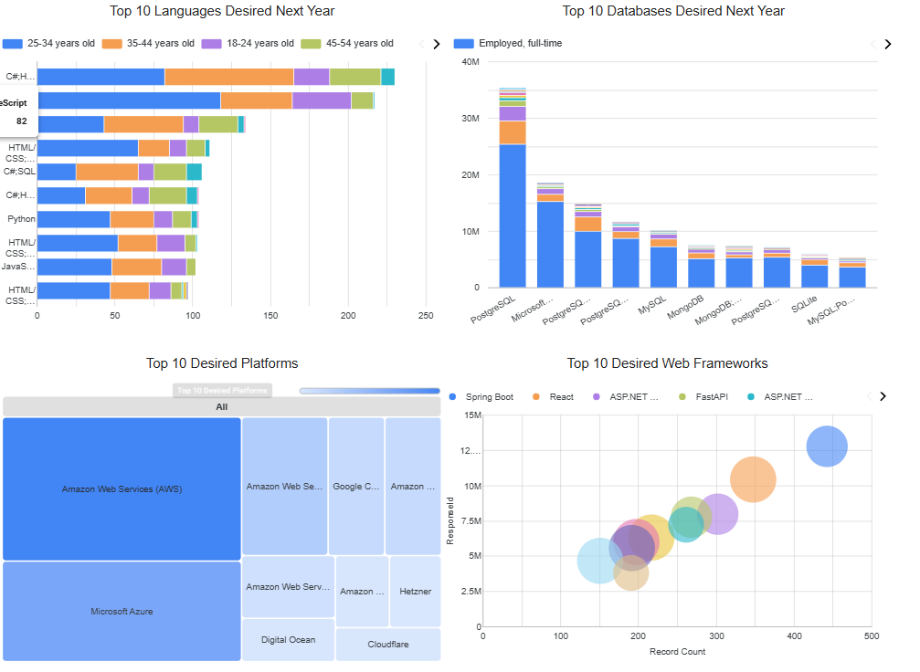
Slide 13
Focuses on Cloud-native tools and Next.js

Slide 17
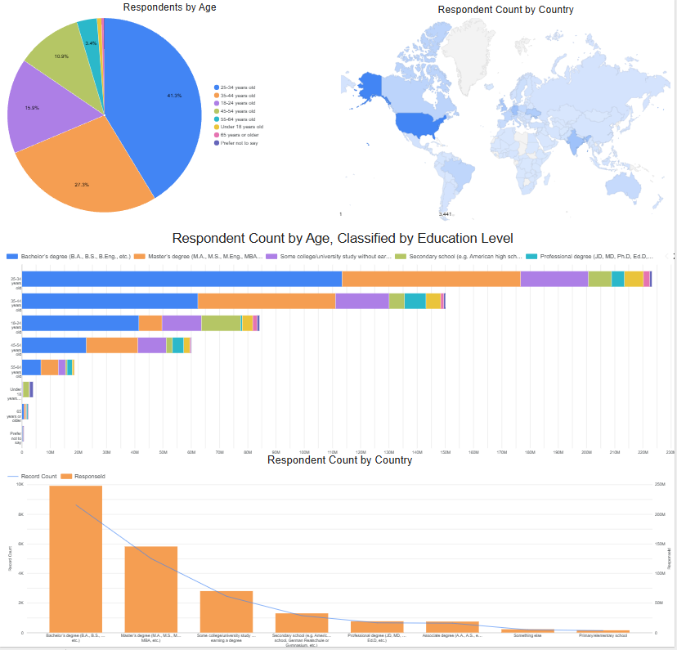
Slide 14
Shows the majority of devs are 25-34 years old

Slide 18
Slide 15: Dashboard Insights Summary
Integrating the dashboards reveals that while the US leads in developer volume, emerging economies are adopting Cloud tools (AWS/Azure) at a faster rate. The younger demographic is also more likely to experiment with "Desired" technologies like Rust.

Slide 19
Slide 16 & 17: Overall Findings & Conclusion
Conclusion: The industry is in a "Hybrid" state; stable technologies (JS/SQL) provide the jobs, but emerging ones (Rust/AI) provide the growth.

Slide 20
Slide 16 & 17: Overall Findings & Conclusion
Key Recommendations:
Master PostgreSQL as it is the undisputed industry standard.
Integrate AI Tools into the development workflow to stay relevant.
Adopt a Hybrid/Remote mindset to attract top global talent.

Slide 21
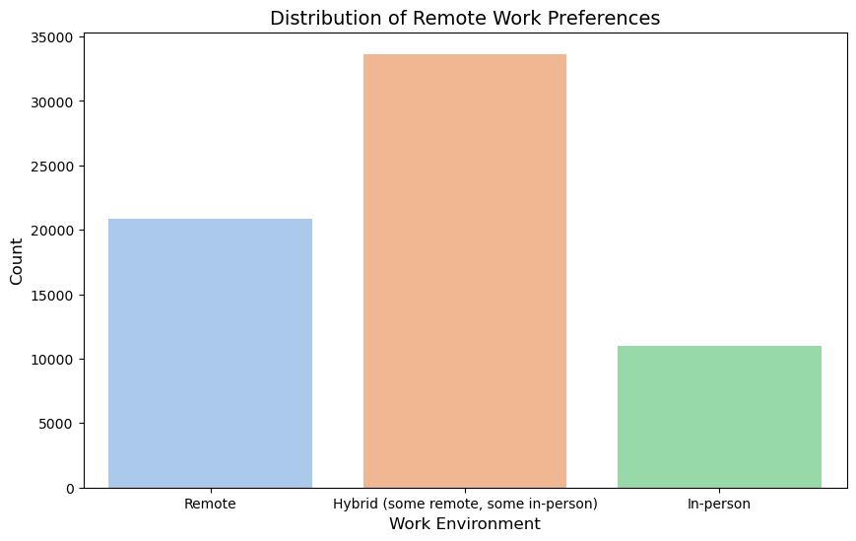
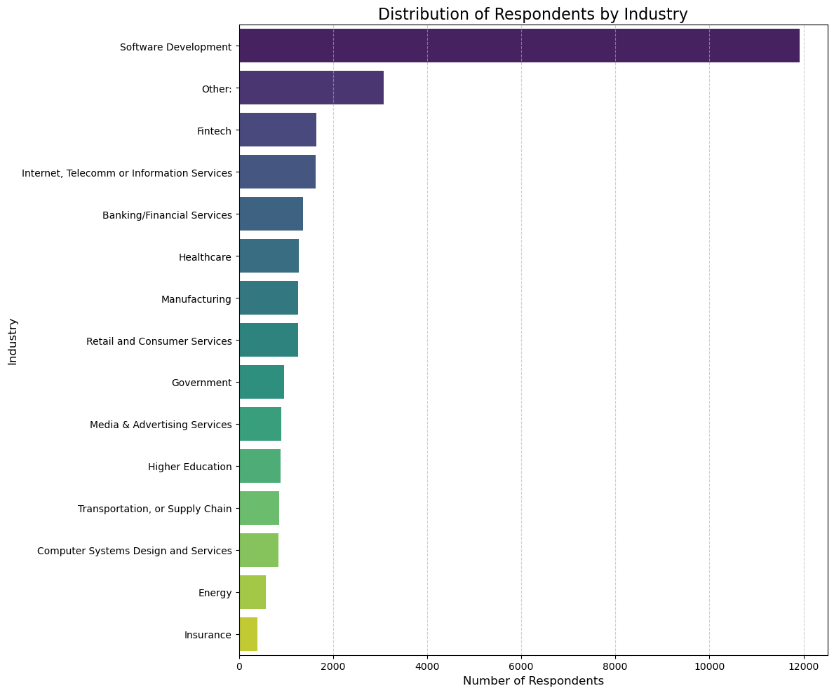
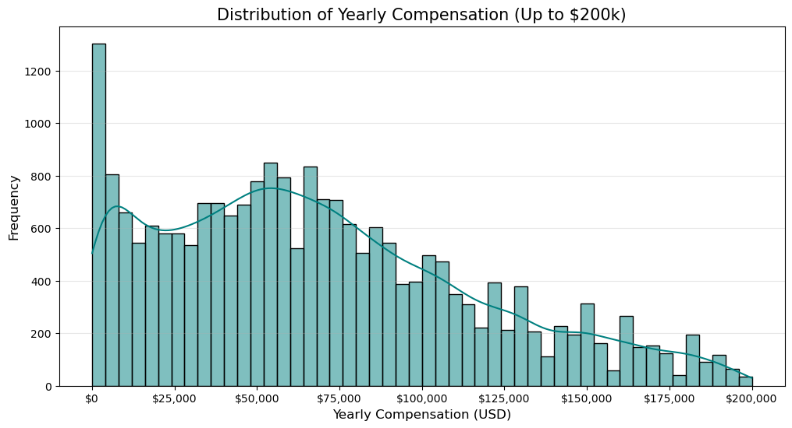
Slide 18: Appendix (Additional Insights)
Distribution of Remote Work Preferences
Industry Distribution
Distribution of Yearly Compensation

Slide 22
Slide 18: Appendix (Additional Insights)
Remote Work Preferences: Most developers prefer Hybrid or Remote, signaling the end of the strict "Office-only" era.
Industry Distribution: The Software Development and FinTech sectors are the largest employers, offering the highest compensation packages.
Salary vs. Experience: Median salary peaks for those with 15-20 years of experience, emphasizing that "Continuous Learning" is vital to maintaining salary growth.

